Slide 1
Water Technologies in Medieval India I
by
Jenia Mukherjee
Department of Humanities and Social Sciences
IIT KHARAGPUR
Notes:
Why not ‘management’?

Slide 2
The changing context
North-west frontier province
‘agricultural revolution’
This set him apart from the peasants of a large portion of the globe, whose knowledge remained confined to a very few crops (Chowdhury & Habib)
new crops – more water (sugar, rice, cotton, wheat)
pre-Islamic methods – inadequate to meet the new agrarian productivity
development and diffusion of water technologies to raise/lift, store and distribute water
Notes:
Numerous food and cash crops cultivated by peasants.

Slide 3
The Sultanate
Iltutmish – construction of reservoir; large lake – Hauz-i-Samshi
  Drinking water for Delhi (Khusrau, Isami); irrigation (Batutta); RW storage
  Re-excavation by Aluddin Khalji
Hauz-i-Alai or Hauz-i-Khas by Alauddin Khalji
  Large square tank with 600 m length and 70 acres breadth
  daryacha or ‘small sea’ that was filled up with water during the rainy season and served the need of water supply to the people of Delhi for the whole year – Ali Yazdi, Zafarnama (p. 108-09)
Notes:
Ibn Batutta - Hauz-i-Samshi – two miles in length and one mile in breadth
Hauz-i-Khas, two miles from the Qutb Minar; it was a large square tank with 600m length and over 70 acres breadth

Slide 4
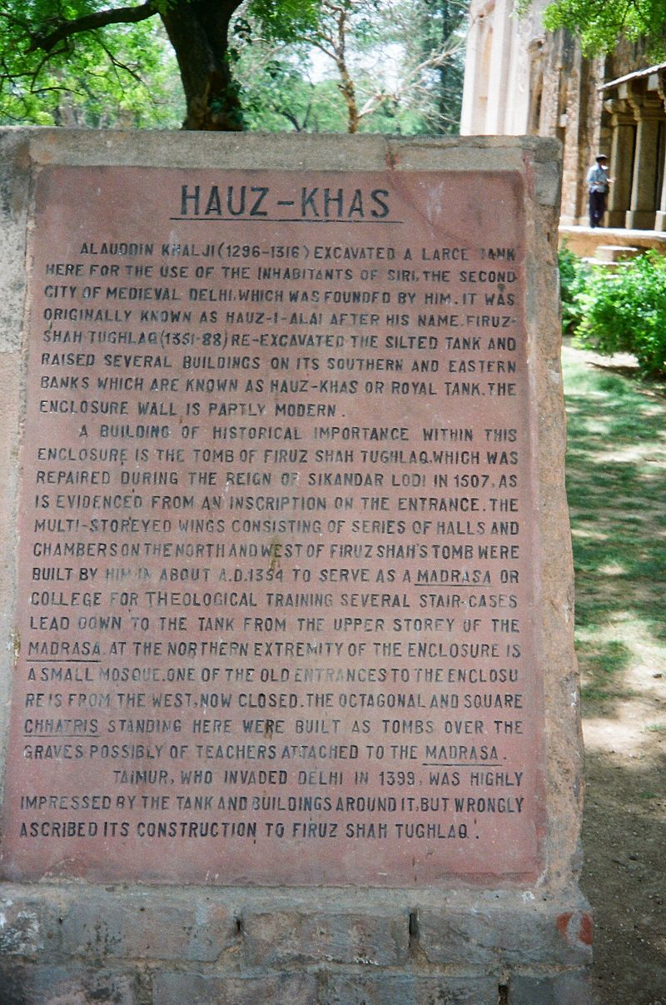
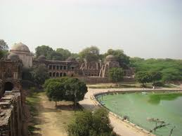

Slide 5
Tughluqabad – Ghiyasuddin Tughluq
  A tank for storing RW; wells (six unearthed)
  The sagacious king ordered the digging of a tank under the elevated fort. Every moment the tank was beset by waves like the seven oceans beneath the Caucasus Mountains – Futuh-us-Salatin
Loans advanced to peasants for digging wells and bunds by Mohammad Bin Tughluq
Notes:
Ibn Batutta - Hauz-i-Samshi – two miles in length and one mile in breadth

Slide 6
Firuz Shah Tughluq’s reign
  water reservoirs, lakes, aqueducts, irrigation channels
  biggest network of canals created (Tarikh-i-Firuz Shahi); two canals: Rajabwah and Ulughkhani to ensure water supply in Hissar Firuza; the Firuzabad canal (1335)
  the canal was extremely important in the area where well 130 feet deep, and the springs often are salt (Colvin 1833)
  large tanks: Haudi Tughluq Shah, Haud-i Qutlugh Khan, Haud-i Shahzada Fath Khan
  use of sluice gates for control of water in dam
Notes:
Shams Shiraj

Slide 7
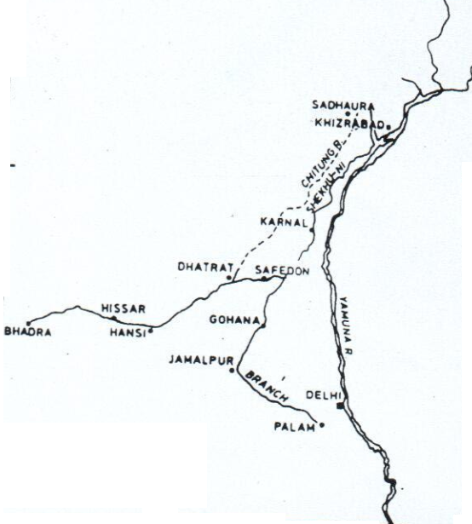
Source: cited in Mukherjee 2008: 283
Notes:
Integrated system with canals, bunds and reservoirs

Slide 8
The Mughals
Well irrigation
most of the province of Lahore is cultivated with the help of well- irrigation (Ain-i-Akbari)
Irrigation tanks in peninsular India
Bunds
Thousands of canals cut from river served towns and villages
History of large canal excavation (maintenance and remaintenance) in the North
  Rajabwah – Akbar, by Shihabuddin Khan – Shihabnahr; Shaikhu-ni
  Mir-i-Ab (the Canal Superintendent)
Notes:
Rajabwah – Akbar, by Shihabuddin Khan who was the governor of Delhi in 1560

Slide 9
‘Nahir-i-Birhist’ or ‘Nahir-i-Faiz’ – Shahjanabad
  Map by Susan Gole (1989)
enters the city and passing through it by an open channel it traverses another extensive aqueduct into the palace (Colvin 1833)
ramifies in opened or covered water courses having outlets to the Jamuna, thus permitting the passage of constant streams of fresh water (Colvin 1833)
Undoubtedly Shahjahan’s Western Yamuna Canal was a considerable feat of engineering, for which its builders have yet to receive due credit (Khan 1999)
Notes:
The Mughal administration under Shahjahan had proposed to advance Rs. 40, 000 – Rs. 50, 000 to farmers in Khandesh and Berar for constructing bunds.
Map by Susan Gole (1989), showing in several panels the alignment of the canal
Inside the fort, it ramifies…

Slide 10
Small system of canals in the Upper Bari Doab, Punjab; Shahnahr
Small canal cut from Tavi to irrigate Ali Mardan’s garden at Sodhra near Wazirabad
Multan crisscrossed by canals
Inundation and well irrigation – Auranzeb
Water works by provincial ministers
  1628-29: Mir Abra’s canal, North Sind
  Darya Khan, Delta
Bandharas – western ghats (Hardiman 2006)
Notes:
A. Burnes, Travels into Bukhara – about Shahnahr and these small canals
Draft of an order for the appointment of Canal Superintendent, administrative documents
David Hardiman,

Slide 11
The Outcome
agricultural productivity
multiplicity of crops
Ain-i-Akbari – revenue rates for sixteen crops of rabi and twenty five crops of kharif in Agra; forty-one crops/annum
seventeenth century – introduction of two major crops – tobacco and maize
sugarcane, grapes, pomegranates, citrus fruits
good quality of crops and fruits – Jean Baptiste Travernier, Jean de Thevenot

Slide 12
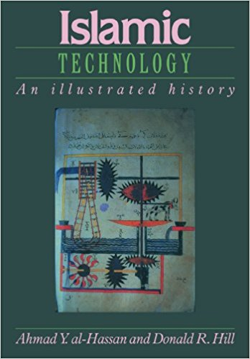
Exploring the Roots
The supply of water irrigation, drinking, domestic and industrial and agricultural purposes has always been a vital consideration in Muslim lands (al-Hassan & Hill 1992)
Central and West Central Asia – Bagdad, Istanbul, Persia, etc.
Hydraulic technologies in the (Mediterranean) region have reaped wonderful rewards: productive fields, beautiful gardens, sparkling fountains and populous cities.

Slide 13
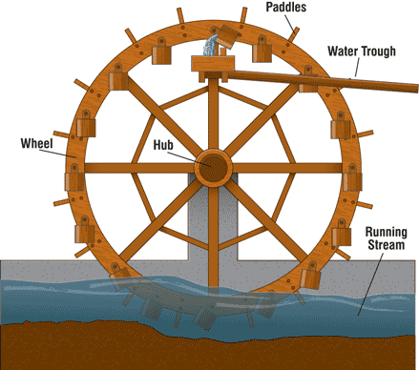
Water lifting devices
Noria
a machine activated by water power
uses the energy derived from the flow of a river
consists of a large, very narrow undershot water wheel
used for lifting water into a small aqueduct
derived from the classical (Hellenistic) world with further improvisation (?); examples from Egypt (Oleson 2000)
Kitab al-Hawi – noria in Iraq 153,000 litres/hour
Notes:
Noria – activated by water power
The proper noria uses the energy derived from the flow of a river. It consists of a large, very narrow undershot water wheel whose rim is made up of a series of containers which lift water from the river to a very small aqueduct at the top of the wheel.
John Peter Oleson,
Some of the norias used in the medieval Islamic world were as large as 20 meters in diameter. It has 120 water collection compartments and could raise more than 95 litres of water per minute.
Muhammad ibn Zakariya al-Razi's Kitab al-Hawi in the 10th century describes a noria in Iraq that could lift as much as 153,000 litres per hour, or 2550 litres per minute.

Slide 14
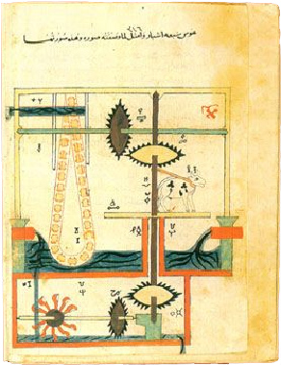
The Persian Wheel (saqiya)
Panchatantras – araghatta
ara – spoked wheel, ghatta – pot
Islamic improvisation – references of intricate device
use of complex saqiyas (200 separate components) by Muslim inventors and engineers (Hill 2002)
Al-Jazari also constructed a water-raising device – both animal and water-driven
Notes:
panchatantra 3rd c. BC
the delivery of power from a driving device to a driven machine and, essentially, to allow lifting water from far greater depths (up to 200 metres), was first employed by Ibn Bassal (fl. 1038–1075), of Islamic Spain

Slide 15
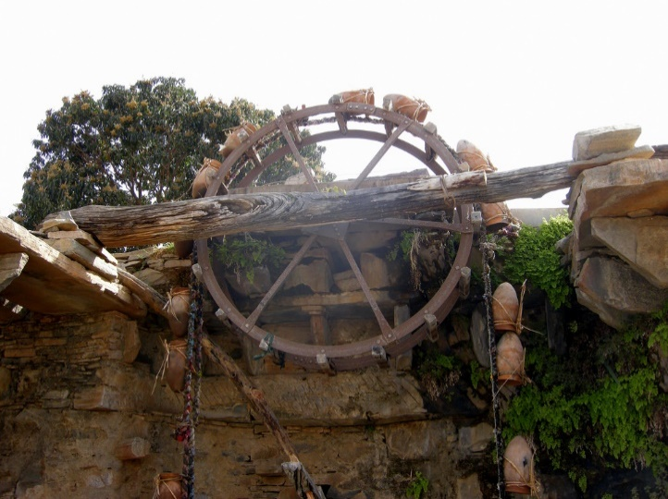
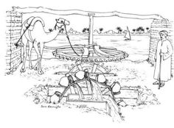
https://www.youtube.com/watch?v=tUIOfwprz6k
Jenia Mukherjee
Humanities and Social Sciences
Notes:
A sakia or saqiya differs from a noria in the way it is powered, and by the fact that it raises water out of a well or body of standing water, not a river. Sakias can have its water-scooping pots or buckets attached directly to a vertical wheel, which makes it look very much like a noria, thus the many confusions; or it can use a so-called pot-garland, a chain of pots slung over the vertical wheel which hangs down into a well which may be up to 8 m (26 ft) deep. The most primitive sakias are driven by donkeys, mules, or oxen. The animal turns a horizontal wheel, which is engaged with the vertical one, and so causes it to turn.

Slide 16
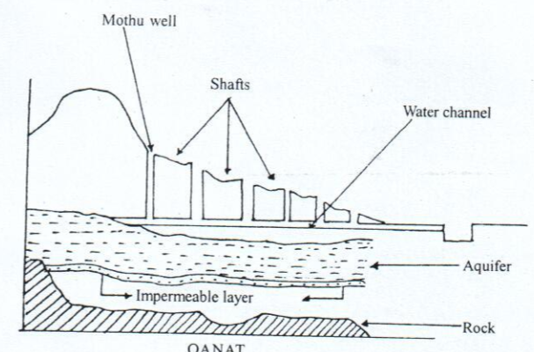
Qanat
Qanat – channel
First millennium BC invention in Persia
a series of well-like vertical shafts
connected by gently sloping tunnels
Delivery of subterranean water to the surface without the need for pumping
water drains through gravity
Iran, Asia, North Africa
Notes:
Qanats are constructed as a series of well-like vertical shafts, connected by gently sloping tunnels. Qanats efficiently deliver large amounts of subterranean water to the surface without need for pumping. The water drains by gravity, typically from an upland aquifer, with the destination lower than the source. Qanats allow water to be transported over long distances in hot dry climates without much water loss to evaporation.
Much of the population of Iran and other arid countries in Asia and North Africa historically depended upon the water from qanats; the areas of population corresponded closely to the areas where qanats are possible. Although a qanat was expensive to construct, its long-term value to the community, and thereby to the group that invested in building and maintaining it, was substantial.

Slide 17
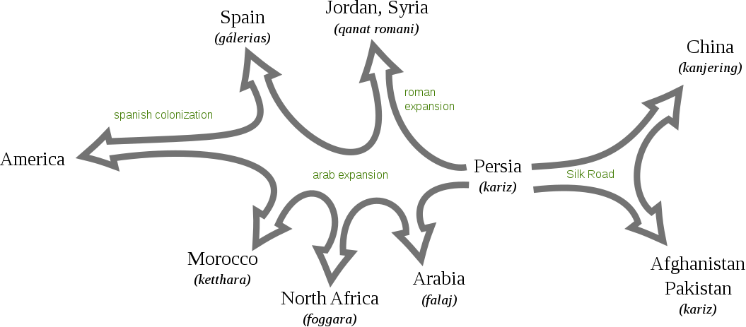

Slide 18
Interrogating imperial categorization
‘Dark Age’? Asiatic mode of production
[proselytizers, autocrats, destroyers of Indian civilization]
Or
Technologically advanced and dynamic society?
(elaborate and sophisticated technologies, tuned to ecological/geographical settings)

Slide 19
References
Chakraborty, D. 2014. Water and Technology in Pre-Mughal India. In Mukherjee, J. (ed.) History and Beyond: Trends and Trajectories. New Delhi: Kunal Publishers.
Chowdhury, Tapan Ray and Habib, Irfan (ed.). 1982. The Cambridge Economic History of India: 1200-1750.
Colvin, M. 1833. ‘On the Restoration of the Ancient Canals in the Delhi Territory’, Journal of the Asiatic Society (15): 105-27.
Hardiman, David. 2006. Small-Dam Systems of Sahyadris. In Arnold, David and Guha, Ramchandra (ed.), Nature, Culture, Imperialism: Essays on the Environmental History of South Asia.
Mukherjee, J. 2008. Water Management in Medieval India: Towards Economic Dexterity and Ecological Sustainability. In Sarkar, M. (ed.), Environment and History: Recent Dialogues. New Delhi: Kalpaz Publishers.
Singh, Abha. Irrigating Haryana: The Pre-history of the Western Yamuna Canal.
Yazdi, Ali. 1888. Zafarnama, B.I. Series, Vol. II. Calcutta: Asiatic Society of Bengal.

Slide 20
References
Al-Hassan, Ahmad Y. and Hill, Donald R. 1992. Islamic Technology: An Illustrated History. Cambridge University Press.
Angelakis, Andreas N. et al. 2016. Underground Aqueducts Handbook. CRC Press. Taylor & Francis Group.
Hill, Donald R. 1984. A History of Engineering in Classical and Medieval Times. Routledge, London, New York. Taylor & Francis Group.
Hill, Donald R. "Engineering", in Roshdi Rashed, ed., Encyclopedia of the History of Arabic Sciences (2). Routledge, London, New York. Taylor & Francis Group. 776.
Oleson, John Peter. 2000. "Water-Lifting", in Wikander Orjan, Handbook of Ancient Water Technology, Technology and Change in History II, Leiden Brill.
Oleson, John Peter. 1984. Greek and Roman Mechanical Water-Lifting Devices: The History of a Technology, University of Toronto Press.

Slide 21


